Slide 1
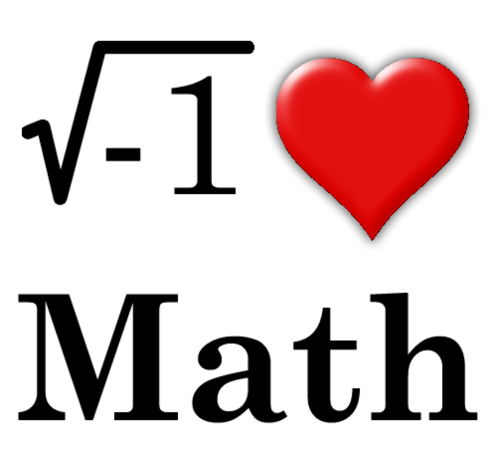
MRHS Math Department
Course Registration Information
Jenni Clarkin, Math ITL jclarkin@hcpss.org

Slide 3
Building a Solid Math Foundation
Is the utmost of importance!
Need to be appropriately placed to get adequate support
Should be challenged but not overwhelmed & requiring a lot of outside help
Not grade focused!! Learning comes better this way with less stress
Mistakes are OK! We learn best through them – not stepping in too often is KEY!
It is NOT recommended to take anything other than Geometry during Summer School.

Slide 4
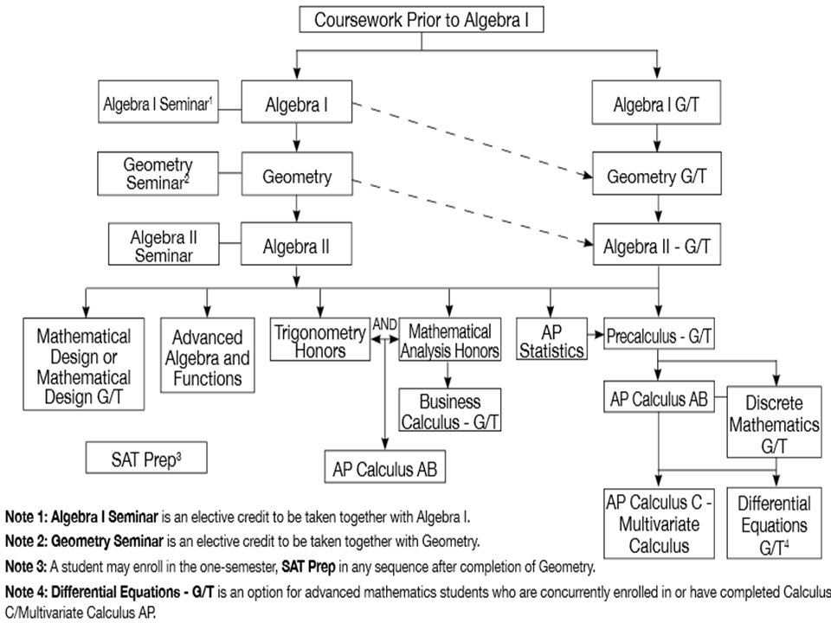

Slide 5
Currently in Common Core 8
Algebra 1
On grade level
Performs well without additional supports
C’s or above on Tests & Quizzes
Teacher will be available as regular to assist students during the class and after school as needed.
Algebra 1 + Algebra 1 Seminar
Students are performing below grade level and/or require extra time to process and master concepts and/or procedural skills
D’s & E’s on Tests & Quizzes
Seminar teacher will be able to pre-teach new material in class, spend extra time on difficult material, give alternative strategies to learn the material, and sometimes do practice tests to prepare for upcoming assessments.

Slide 6
Currently in Algebra 1
Repeat Algebra 1
Consistent difficultly with material and could benefit from a stronger foundation
D’s and E’s on Tests & Quizzes
Geometry
Passed Algebra 1 but may need some assistance with mastering the content
Defaults to procedural knowledge and may lack fluency in algebraic computation (e.g. solving equations, factoring, etc.)
May demonstrate difficulty with logical reasoning and making connections
B’s, C’s & D’s on Tests & Quizzes
Geometry GT
Demonstrates proficiency in logical reasoning and making connections without additional supports.
Excels in productively struggling through new material while working individually and in groups.
A’s on Test & Quizzes, scored at least a 3 on PARCC
Geometry Seminar also available
Algebra 2 GT concurrently for exceptionally strong students with 4 or 5 on PARCC

Slide 7
Currently in Geometry GT
Algebra 2
Student would benefit from a slightly slower paced class than Algebra 2 GT. May require extra time to process and master concepts and/or procedural skills
Some gaps may be evident in Algebra I skills, both conceptually and procedural
Look at what they did in Algebra 1 NOT Geometry - Some A’s, Most B’s & All C’s on Tests & Quizzes
Algebra 2 GT
Strong foundation in algebraic skills.
Able to work independently, responsibly, and perseveres while problem-solving
Scored at a 4 or higher on PARCC - Algebra 1
A’s & B’s on Tests & Quizzes in Algebra 1 & Geometry GT
Repeat Geometry
Consistent difficultly with material and could benefit from a stronger foundation
E’s on Tests & Quizzes

Slide 8
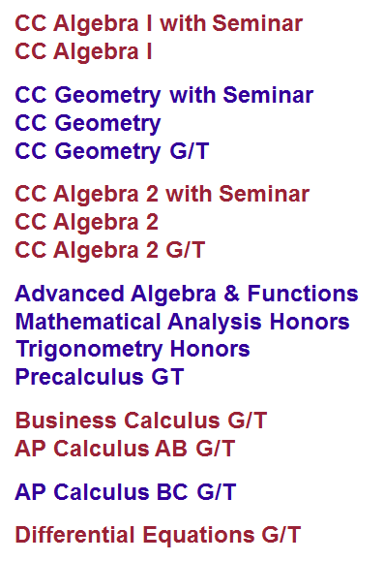
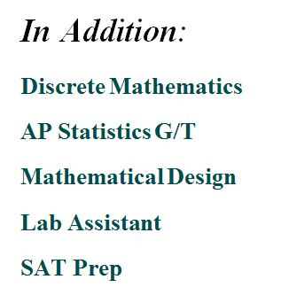

Slide 9
In the Course Catalog
Graduation Requirements – pages 2-3
Assessment Requirements – pages 4-5
General Information – pages 10-24
Mathematics – pages 107-112

Slide 10
