Slide 1
Marriotts Ridge High School
Class of 2019
Notes:
Insert your school’s name on slide

Slide 2
OBJECTIVES
I will understand the process for obtaining the materials to apply for post-high school education including:
Transcript Request Form/Process
Teacher Recommendation Requests/Process

Slide 3
THE KEY PLAYERS
COUNSELORS
MRS. LITTLE A - Ci
MRS. DUBBS Ci-I
MS. HILDRETH J-L
MS. NELSON M-Sc
MR. JOHNSON Se – Z
REGISTRAR: MS. DEISON
SS SECRETARY: MS. LEAF
Notes:
Discussion - quick check in to see if you know your counselor/ add picture of registrars and other essential support (if applicable to your school)

Slide 4
Did you complete the …
Teacher Information Form #1
Teacher Information Form #2
Counselor Information Form
Parent Information Form
Update your Resume and upload on Naviance!

Slide 5
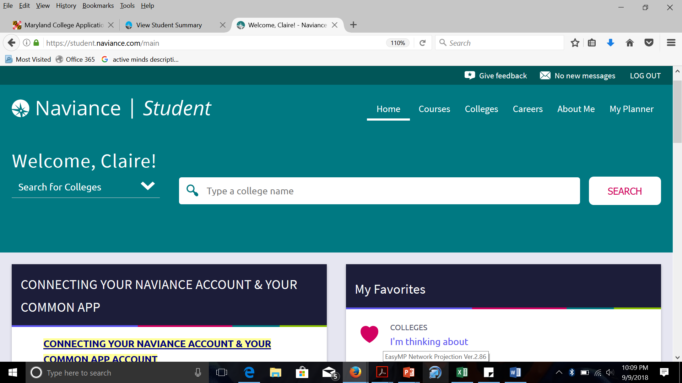

Slide 6
IMPORTANT TRANSCRIPT INFO
A Transcript is an official copy of a students academic record.
It includes the following:
Course names from 9th-11th grade
Final grade for each course
Senior courses
Weighted AND Unweighted GPA
Class Rank – AVAILABLE IN OCTOBER
Standardized test scores (SAT, PSAT, ACT,
or AP scores) are not included.

Slide 7
SENIOR GRADES COUNT
COLLEGES/UNIVERSITIES WILL REQUEST
MID-YEAR GRADES
1ST QUARTER, 2ND QUARTER, AND MID TERM EXAM GRADES WILL BE ON YOUR MID-YEAR REPORT.
FEBRUARY: We will automatically send mid-year reports to ALL colleges/universities that you requested in a Transcript Request Form.

Slide 8
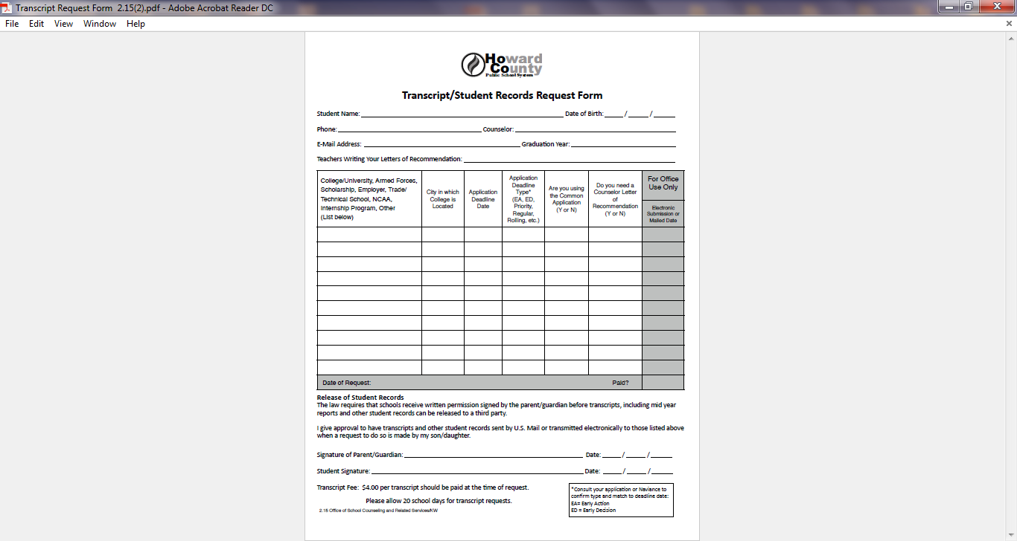

Slide 9
IMPORTANT TRANSCRIPT INFO:
Requests due to Registrar, Ms. Deison 20 school days prior to college deadlines
Refer to the REQUEST DUE DATES SHEET!
First 3 Official transcripts free $2 per transcript after that
Ms. Deison will be available to take your Transcript Request Forms & Pink Waiver Form: DURING ALL LUNCH SHIFTS MONDAY THROUGH FRIDAY
Transcripts/Rec’s submitted by your counselor either: Electronically OR Through the mail

Slide 10
TEACHER
LETTER OF RECOMMENDATION
Multi-step process
verbal request
submit Yellow form
invite through Naviance (AFTER YOU SUBMIT YOUR TRANSCRIPT REQ FORM TO MS. DEISON)
Know how many letters a college/university will accept
Submit yellow request form to teacher(s) 20 school days prior to college deadline

Slide 11
TEACHER REC REQUEST FORM

Slide 12
INVITE TEACHERS ON NAVIANCE
WHEN? AFTER YOU SUBMIT YOUR TRANSCRIPT REQUEST TO MS. DEISON
PROCESS:
Colleges Tab, Letters of Recommendation
Add Request button, choose teacher, choose schools, write a personal note and submit.
TEACHERS WILL NOT BE ABLE TO SEE YOUR INFO SURVEY, RESUME, PARENT QUESTIONNAIRE UNTIL YOU DO THIS!

Slide 13
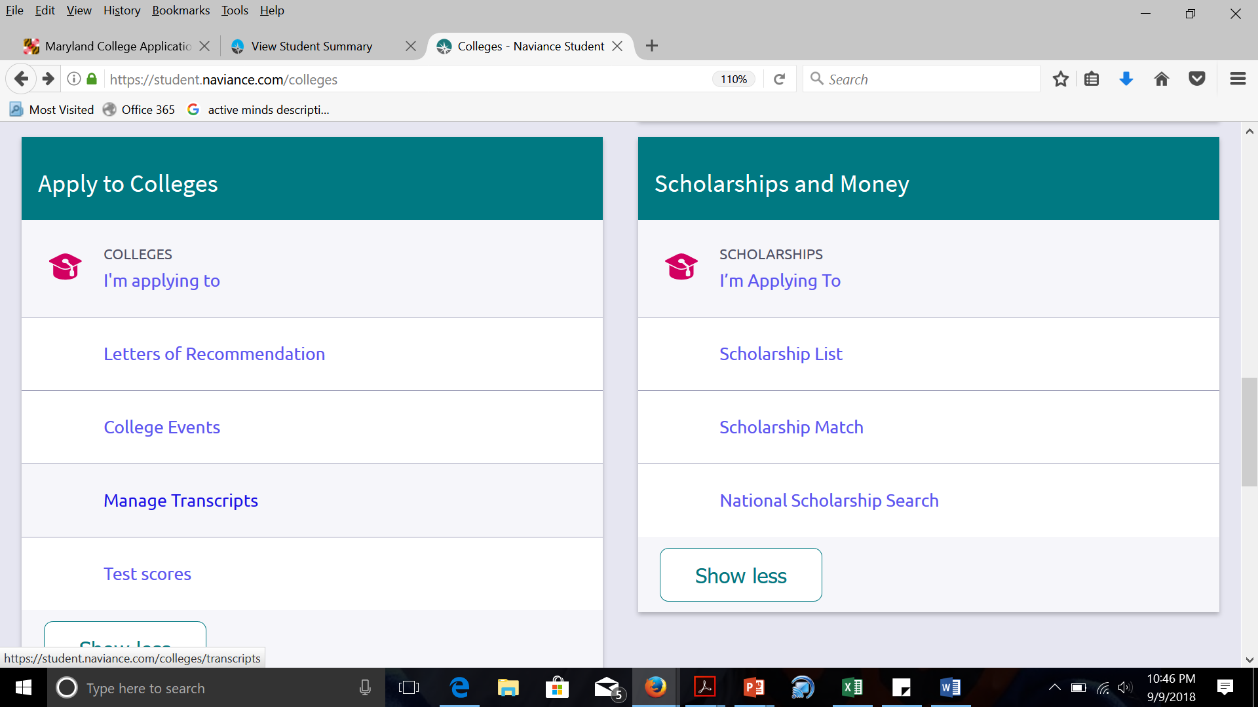
COLLEGES TAB

Slide 14
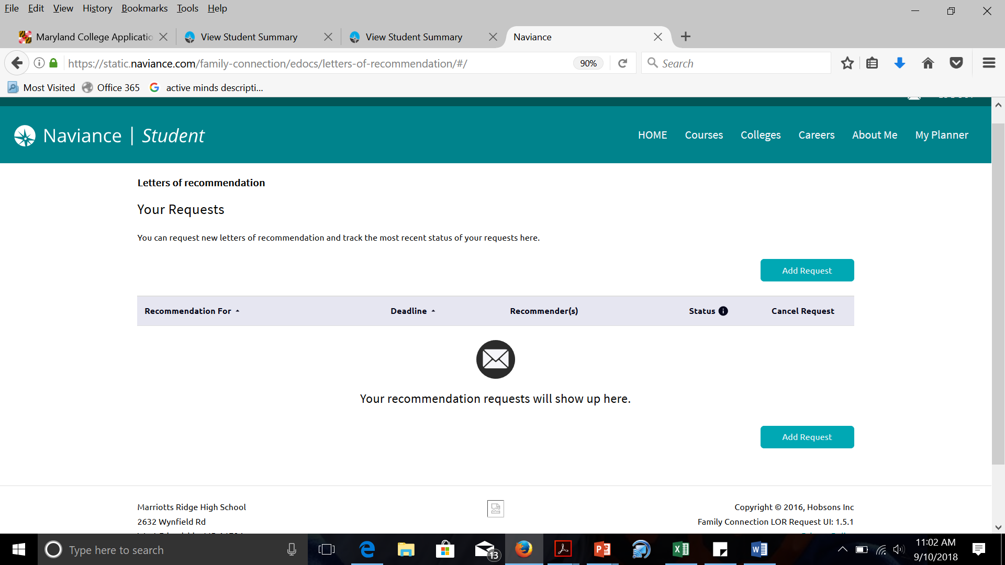
LETTERS OF RECOMMENDATION request

Slide 15
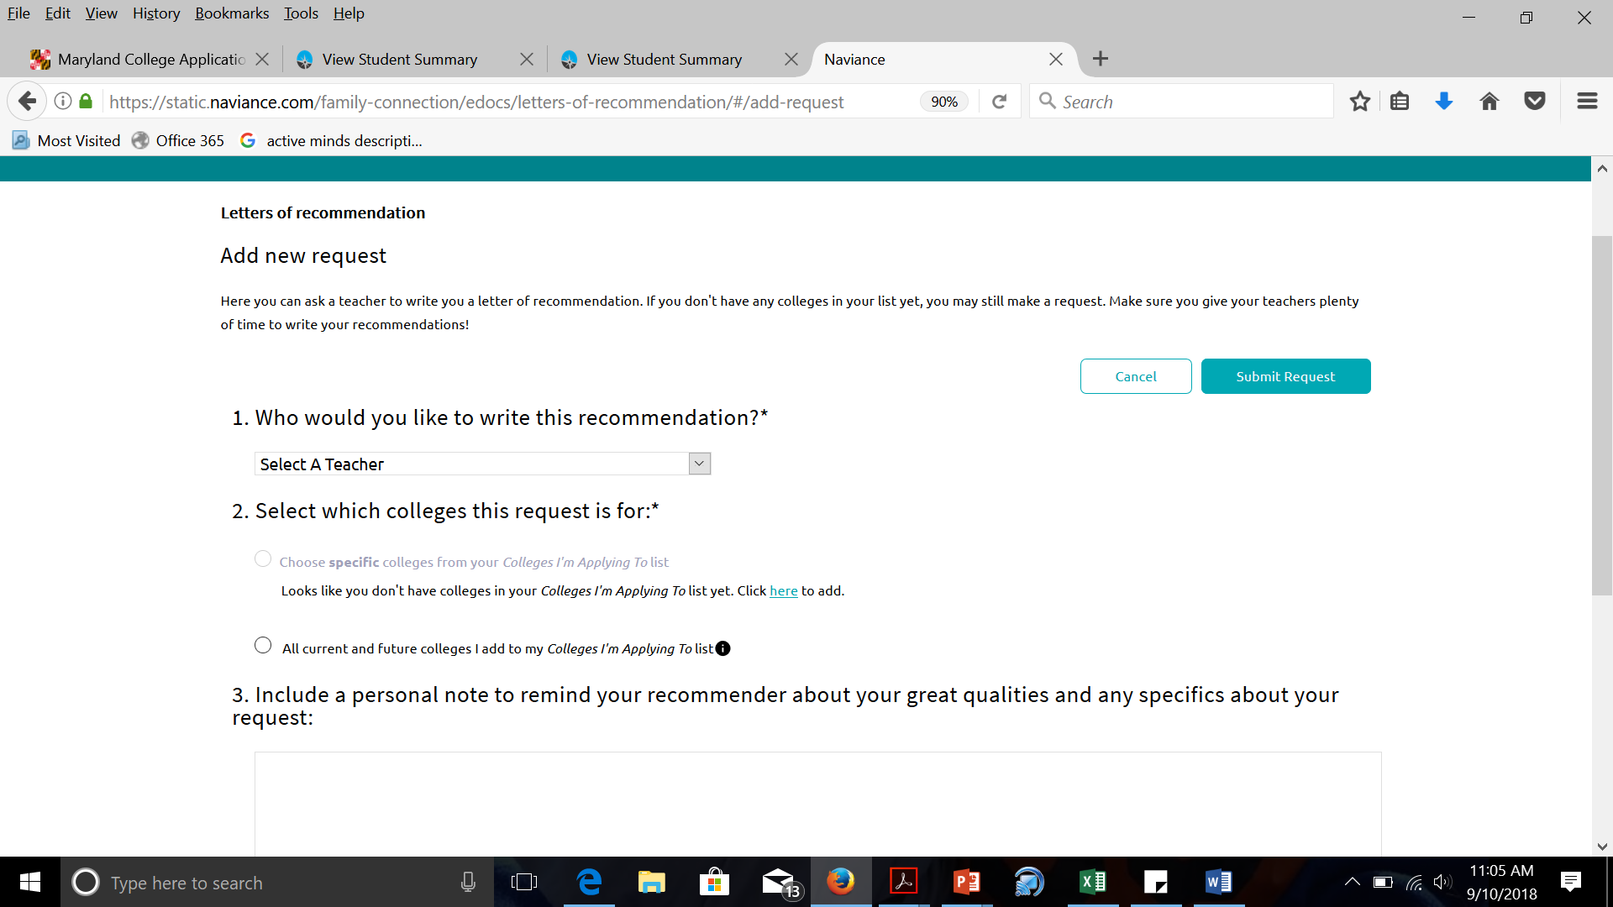
LETTERS OF RECOMMENDATION request

Slide 16
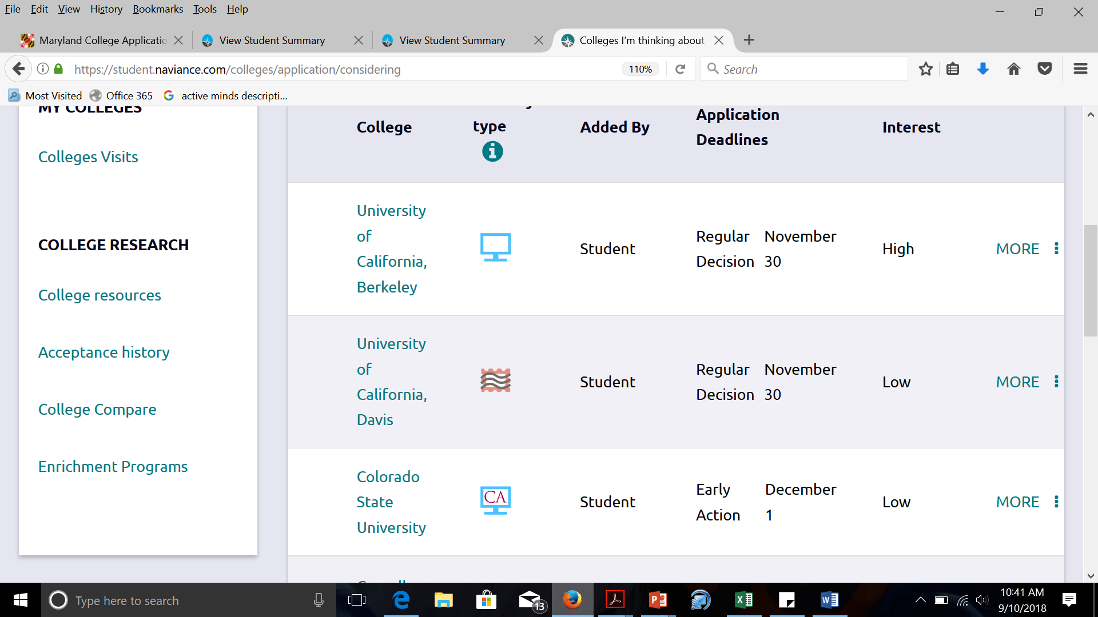
DO MY SCHOOLS ACCEPT ELECTRONIC SUBMISSIONS?
GO TO: -Colleges I’m Thinking about
OR -College/University Page -Admissions tab, scroll to the bottom of page to Application info
-Under Important Policies

Slide 17
COLLEGES/UNIVERSITIES MAY REQUIRE A TEACHER EVALUATION FORM OR A SCHOOL COUNSELOR FORM …
We don’t need this form.
Teachers and counselors will send this form (and the recommendation) ELECTRONICALLY.
We will print out the form and send it to schools who do not accept electronic submissions.

Slide 18
CONNECTING YOUR NAVIANCE ACCOUNT and YOUR COMMON APP ACCOUNT
Matching Video (available on your Naviance homepage)
Why is this important?
Allows you to electronically sign Common App FERPA Waiver
We cannot send your transcript until this has been signed
If you are not using COMMON APP for any school, you do not need to do this. We can use your signed pink waiver form for all other submission types

Slide 19
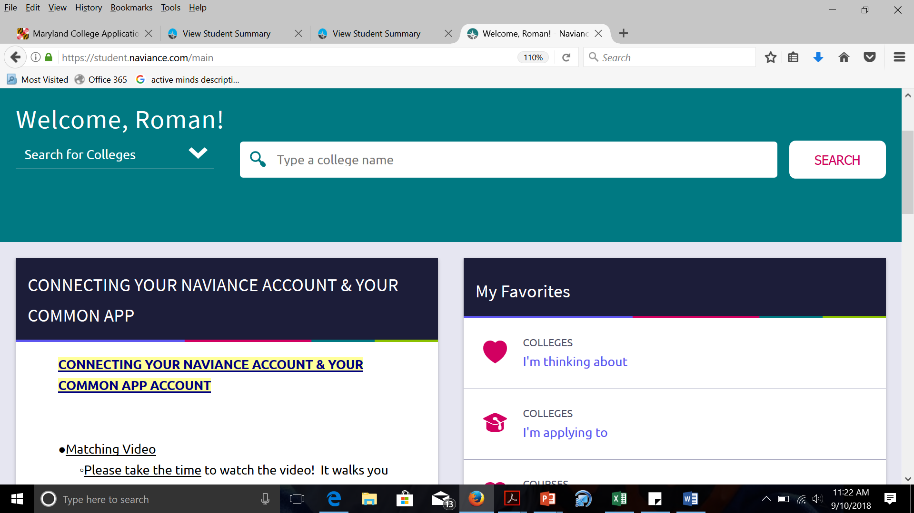
CONNECT today!!!

Slide 20
ONCE YOU HAVE:
Submitted a Transcript Request Form & Pink Waiver Form
Completed each step of the Letter of Rec. process
Designated that my SAT/ACT scores be sent directly from college board or the ACT to the schools I am applying to
Continue to work on your applications
We will work on sending your transcripts and recommendations by the deadline.

Slide 21
WHAT HAPPENS NEXT?
We will submit your transcripts and letters by the college deadline date!
Your colleges/universities will upload and review your materials according to THEIR schedule.
It may take a few WEEKS for colleges/universities to match your materials with your application.
CALL your admission office and confirm receipt if you’re worried.

Slide 22
FINAL NOTES…
Unofficial transcript
Review with a parent/guardian for accuracy
See your counselor if anything is missing or incorrect
Weighted/Unweighted Class Rank & GPA
CALCULATED EARLY OCTOBER - NO EXCEPTIONS!
Don’t forget… YOU must send your ACT/SAT scores directly to the colleges from college board or the ACT
Notes:
Counselor Note:
Some schools distribute an unofficial transcript during this lesson allowing families to partner with counselors to ensure all grad. requirements are being met and have been recorded accurately.

Slide 23
FINAL NOTES… FOR PARENTS
Fill out Parent Information Form on Naviance! ”about me” tab, “surveys to complete” on Naviance
If you need your Naviance Log in – email your student’s counselor and we will have the Naviance System send you an email with directions!
FAFSA OPENS OCTOBER 1st! The sooner the better!
Notes:
Counselor Note:
Some schools distribute an unofficial transcript during this lesson allowing families to partner with counselors to ensure all grad. requirements are being met and have been recorded accurately.

Slide 24
Senior Parent Postsecondary Planning Night
Thurs.,SEPTEMBER 20th
6:30 PM

Slide 25
COLLEGES VISITING MRHS!
COLLEGE VISITS – SIGN UP FOR VISIT RIGHT ON NAVIANCE!
YOU WILL GET AN EMAIL REMINDING YOU OF THE VISIT 24 HOURS AHEAD. PRINT THE EMAIL AND USE IT AS YOUR PASS (SHOW TO TEACHER) TO ATTEND THE VISIT.
ATTENDANCE WILL BE TAKEN AT EVERY VISIT AND FORWARDED TO THE STAFF.

