Slide 1

Back to School Night
Marriotts Ridge
High School
Notes:
Goldeisen

Slide 2

VISION
Every student is
inspired to learn
and empowered
to excel
MISSION
We cultivate a vibrant
learning community that prepares students to thrive
in a dynamic world
www.hcpss.org/vision
Notes:
Goldeisen
Howard County Public School System is entering the 4th year of a 5-year strategic plan: Vision 2018: Fulfilling the promise of preparation.
Vision 2018 is our roadmap toward becoming a world-class school system that fulfills the promise of preparation to every student. The promise of preparation means that every child develops the skills and knowledge they need to succeed in college, without the need for remedial courses, or in a high-wage career by the time they graduate high school.
Our school system vision: Every student is inspired to learn and empowered to excel.
Our mission: We cultivate a vibrant learning community that prepares students to thrive in a dynamic world.

Slide 3





School News and Information
Video
Email
In Person
Social Media
Print
Notes:
Goldeisen
School Communications – OVERVIEW
Engaging parents and families as partners in education is a key priority of the HCPSS Strategic Plan, and is one of my/our school’s highest priorities. We use several communications tools to keep parents informed of what’s happening in the school and provide the information you need to make informed decisions regarding your child’s education. I’ll describe each of these in a moment [covered on following slides].
Often – personal communications are best.
Most important though, is that you feel comfortable reaching out to teachers and administrators whenever you have a concern or question. We’re happy to meet with parents, have you visit the classroom – call the school office with questions or to set up a convenient time. We also value parent involvement in school activities.
Feel free to contact any teacher or administrator via Email, or make an appointment to meet to discuss your concerns.

Slide 4
HCPSS News
Email
Text
School News
HCPSS News
Emergency Notices
Optional for
Emergency Notices
Only
Details: www.hcpss.org/hcpss-news/
Notes:
Goldeisen
Parents receive news and announcements from our school and from the school system via the HCPSS News service.
Parents are automatically registered for this service. Email messages are delivered to the contact information that you provide in the Family File.
You will receive via email:
School newsletters & other communications
System-level announcements
Emergency notifications (school closings/delays).
Parents are given the option to receive text messages. New parents are sent a text message to opt-in for text alerts. – if you didn’t receive this, visit www.hcpss.org/hcpss-news/ to troubleshoot. Text alerts are sent to the mobile phone number identified in the Family File.
If you were already opted-in to receive text messages last year, and your phone number has not changed, you do not need to opt-in again.
Community members and others can sign up for this messaging service at www.hcpss.com/hcpss-news (or visit the home page www.hcpss.org)

Slide 5


School Closings/Delays
www.HCPSS.org
HCPSS News
@hcpss
HCPSS TV
HoCoSchools
Verizon 42
Comcast 72
Notes:
Goldeisen
School Delays and Closings (usually weather-related) are communicated through several channels:
HCPSS homepage: www.hcpss.org -this is the first and most complete source of information
HCPSS News emails and texts
Social media: Twitter & Facebook
HCPSS TV – channel 42 (Verizon) and 72 (Comcast)

Slide 6
MRHS website
Announcements and news
School calendar
Staff directory
Academics
Student activities, sports, clubs
Links to HCPSS Connect and other resources
And more
MRHS.hcpss.org
Notes:
Goldeisen
Our school website is a one-stop destination where you can quickly find:
School calendar
Announcements and news
Academic departments
Student activities, sports, clubs
Staff directory and email links
Quick Links to HCPSS Connect, system website, and other resources
It provides mobile access and user-friendly navigation.

Slide 7


Social Media
Marriotts Ridge Twitter: @hcpss_mrhs
HCPSS Facebook: www.Facebook.com/HoCoSchools
HCPSS Twitter: www.Twitter.com/HCPSS
Interact with the Superintendent:
Twitter: www.Twitter.com/SuperHCPSS
Blog: superintendent.hcpss.org
Notes:
Goldeisen
Link to our social media sites:
Get up-to-the-minute updates, news, student and school happenings, and announcements
Interact with the school and system

Slide 8


MOBILE APP
Notes:
Goldeisen
The HCPSS Mobile App is available free to download for iphones, iPad, and Android devices in the app stores (search for “HCPSS”).
The app makes it quick and easy to find the information you need, when you need it. It provides:
Simplified access to information
On-the-go access and quick links
Compiles messages and calendar dates from multiple schools as well as district information, if you have children attending other schools as well.

Slide 9

SYNERGY STUDENT
INFORMATION
SYSTEM
CANVAS
LEARNING
SYSTEM
FAMILY FILE
www.hcpss.org/connect
Notes:
Cam
HCPSS Connect is the one-stop portal to access Synergy, Canvas, and the Family File.
The Synergy Student Information is the source for official student records & grades.
It gives teachers, administrators, and parents with the digital tools to easily access student information.
The Canvas Learning System gives teachers, parents, and students tools to communicate, collaborate, and connect.
Both systems are extremely easy to learn and to use.
Find full details and instructions online at www.hcpss.org/connect
Benefits of HCPSS Connect for Parents, Students & Teachers:
Improved & consistent user experience
Common digital platform for all schools & grades
Improved communication and collaboration
Anytime/anywhere across multiple devices
Single sign-on - 1 user/pass for HCPSS Connect

Slide 10

Parent contact information
Medical data and contacts
Afterschool transportation
Data privacy preferences
www.hcpss.org/connect
Notes:
Cam
The Family File on HCPSS Connect provides important information about your student. All information is confidential.
It is important that parents update the Family File with current data about your student including:
Parent emails and phone numbers
student medical contact data
afterschool transportation options
data privacy options
Log into HCPSS Connect and click the My Account tab. Save your changes by clicking the Update Account button.
Family File now remains open throughout the school year, so you can make changes at any time they occur.
Parents without online access can provide this information through a paper “Emergency Procedure and Confidential Student Information” form. Contact the school office for a copy of this form.

Slide 11


Getting Help
Login and Password assistance:
Contact School Office
Guides and Resources:
HCPSS Connect Homepage
Notes:
Cam
Parents will continue to use the same log in credentials as in prior years.
Parents of students new to HCPSS are mailed their login information (US Mail)
For help with your login or password: call the School Office
For help in using Canvas, Synergy, or the Family File, see the many guides and resources on the HCPSS Connect homepage (www.hcpss.org/connect)

Slide 12





By September 2016
Teacher Homepage
CANVAS
Course information
Digital Tools
Calendar due dates
1st and 2nd Quarters
Calendar test dates
3rd and 4th Quarters
Assignment details
Notes:
CAm
CANVAS EXPECTATIONS for teachers the 2016-2017 school year:
This year all teachers will be posting information in the Canvas area in HCPSS Connect.
Targets for each quarter:
By September 2016
Teacher Homepage - Update and maintain teacher homepage; transfer or update content from the pre
Course information - Transfer or update content from previous year's course (s) into current year's course(s)
Digital Tools - Include information on digital tools such as websites or applications that require an account on teacher homepage
Calendar due dates – Post long-term project due dates on day they are assigned
1st and 2nd Quarters
Calendar test dates – Post test dates on the Canvas calendar 3 school days in advance.
3rd and 4th Quarters
Assignment details: Include details such as directions, materials, links, resources, etc. as appropriate.

Slide 13
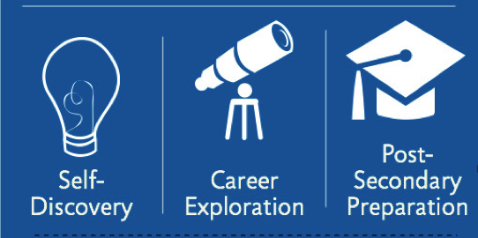
211,284
student visits 2015-2016 school year
Naviance
20,004
transcripts requested and
sent to colleges
906
different colleges applied to
A college and career readiness platform that connects
student achievement with
post-secondary planning
$22,386,208
in scholarships
Notes:
Meghan
Naviance is a powerful online tool that gives each secondary student an opportunity to learn about themselves, and create a plan so they know what their direction is.
Components:
Goal setting – Students establish meaningful goals for the future, create personalized, task-oriented plans for achieving those goals, and monitor progress along the way.
Naviance helps connect strengths to academic goals. It identifies a student’s preferred learning style; helps them discover the elements that would make a career satisfying to that person, and includes career interest profile with information on suggested careers.
Career planning – Build self-awareness, explore careers that match personality types and interests, and understand what’s required to pursue those careers. It includes 3552 short videos that show people's experiences in different careers.
Course planning – Create course plans for middle schools and high school, understand the impact that course choices have on future goals, and even consider higher-level classes based on academic history and teachers’ recommendations.
College planning – Plan, prepare, and enroll in post-secondary institutions by providing insight into the college admissions process. Identifies suggested colleges based on info in student’s profile.
Students can take any Naviance assessment as often as they want, so as their interests and skills evolve, they can get greater insight. It has very high interest for students, and they enjoy using it. Naviance includes an iPhone app.
Naviance allows students, parents and teachers to be engaged and collaborate in helping their child. Parents and teachers can log into child's profile.
Last year, HCPSS high school students visited Naviance more than 162,000 times.
High school parents visited Naviance more than 15,000 times.

Slide 14

FAFSA: Free Application for Federal Student Aid
New application window: Oct 1 – Mar 1
Apply fall of senior year for best consideration
All students should apply; required by
many colleges and scholarship organizations
Apply online: fafsa.ed.gov
Notes:
Meghan
Students are now able to file a 2017–18 FAFSA as early as Oct. 1, 2016, rather than beginning on Jan. 1, 2017. This earlier submission date is a permanent change, enabling students to complete and submit a FAFSA as early as October 1 every year.
Beginning with the 2017–18 FAFSA, students will be required to report income information from an earlier tax year. For example, on the 2017–18 FAFSA, students (and parents, as appropriate) will report their 2015 income information, rather than their 2016 income information.
Students should apply in the fall of their senior year. Financial aid is distributed on a first come, first served basis, so early application is encouraged.
All students should apply–even if they may not be eligible for need-based aid.
FAFSA is used by many colleges and scholarship organizations as part of application requirements.
Federal and Maryland deadline for applications is March1, 2017.

Slide 15

PARCC
Notes:
Choya
Partnership for Assessment of Readiness for College and Careers (PARCC) is the name for the standardized reading, writing and mathematics assessments implemented in all Maryland schools. PARCC assessments are directly aligned to the Common Core standards. PARCC replaced the Maryland School Assessment (MSA) for math and reading/English language arts and the High School Assessments in English 10 and Algebra I.
Changes to the PARCC Assessment:
Last year the PARCC consortium shortened the overall testing duration:
1. There is just one window for English Language Arts and Math—30 days in Spring.
2. The tests are shorter by about 90 minutes overall.
3. Students have 6-7 PARCC testing sessions (vs. 8 or 9 during the 1st year PARCC was implemented).
PARCC benefits:
Indicates how closely students, beginning in Grade 3, are on track to graduate college- and career-ready.
Gives teachers regular results to guide learning and instruction.
Provides data comparable across districts and states.
Scoring:
The PARCC assessments are on a 5 point scale. 1-Did not yet meet expectations, 2-Partially met expectations, 3-Approached expectations, 4-Met Expectations, and 5-Exceeded expectations:
In grades 3-8, ratings of 4-5 indicate students are academically well-prepared to engage successfully in further study.
In high school courses, a 4-5 indicates students are are on track to graduate prepared for colleges and careers and in future years will be used by in state community colleges for placement in credit bearing courses.
Students hand-carry results home in the first few weeks of the following school year

Slide 16

PSAT – Grades 9-11
Notes:
Choya
Grade 10 and 11 students will take the PSAT on October 19. This year, Grade 9 students will also be participating as part of a no cost online pilot.
The PSAT is a good indicator of how a student will perform on SAT and ACT college entrance exams. it is important that every student take this test seriously and do their very best.
Taking the PSAT benefits every student – whether college-bound or planning to enter a career upon graduation. The newly designed PSAT and corresponding reports provide areas for improvement and link the students College Board account to personalized study resources in Khan academy.
PSAT results also indicate whether or not a student is ready to participate successfully in an Advanced Placement (AP) course. The PSAT AP Potential Index is a useful indicator of can be used to identify students who may be ready for AP courses.
Home reports are sent home with students in Dec/January. If students record an email address on their test booklet, they will receive an email with results prior to the release of paper home reports.

Slide 17

SAT – Grades 11-12
Excellent preparation
for college
Notes:
Choya
The SAT is a standardized test, published by the College Board, designed to measure high-school level knowledge in three sections: critical reading, writing, and mathematics. Each section is scored on a scale from 200 to 800.
Most students take the SAT during their junior or senior year of high school. Most colleges and universities consider the SAT, in addition to other student information, when making admission decisions.
College Board recently redesigned the SAT to more accurately predict student readiness for college-level work, to reflect the knowledge and skills that are essential for college success, and to align with the rigorous instruction taught in the best high school courses.
The SAT is a standardized test, published by the College Board, designed to measure high-school level knowledge in three sections: evidence based reading and writing, mathematics and an optional essay. Evidence based reading and writing, and mathematics are scored on a scale from 200 to 800. The essay will receive three scores between 2 and 8.
Most students take the SAT during their junior or senior year of high school. Most colleges and universities consider the SAT, in addition to other student information, when making admission decisions.
College Board recently redesigned the SAT to more accurately predict student readiness for college-level work, to reflect the knowledge and skills that are essential for college success, and to align with the rigorous instruction taught in the best high school courses.
Changes in the new SAT include:
Students must support answers based on evidence found in a variety of sources.
The essay requires analysis of a variety of sources, a skill that is expected in many college writing assignments.
The math section is better aligned with current research and college preparatory standards.
Students apply reading, writing, language and math skills to answer questions in science, history and social studies contexts across all components of the exam
Every test includes an excerpt from one of the founding documents (e.g., Declaration of Independence, Bill of Rights, Federalist Papers) with questions pertaining to concepts such as freedom, justice and human dignity.
No scoring penalty for wrong answers.
[If applicable:] Students can sign up for optional SAT Preparation courses here at the school. We’ll provide info on those later in the year.
SAT tests are given on Saturdays in the spring.
Find schedules, and more information about the test on the College Board website, www.collegeboard.com

Slide 18

Advanced Placement (AP) – Grades 10-12
Excellent preparation
for college
Scores of 3-5 can
earn college credit
ALL students should consider AP
Notes:
Choya
The AP exam program is run by the College Board. Toward the end of each school year, students can take these very rigorous exams in a wide variety of subjects. AP exam scores range from 1 to 5, and many colleges accept scores of 3, 4, or 5 in lieu of taking a college course. This means that a student can enter their freshman year of college with college credit already under their belt. And it translates to real savings – you’re getting a college course at no cost.
Even for students who simply take an AP course but choose not to take the AP exam, research shows that just the course alone is beneficial. Students who experience the rigor of an AP course are better prepared to succeed in a college course.
The bottom line is that Advanced Placement is a great preparation for college. We encourage all Grade 10-12 students to consider taking AP classes.
INSERT TEST DATE Window -- for those who elect to take the test

Slide 19

NGSS Science Curriculum
NGSS Integrates:
Scientific and engineering practices
Crosscutting concepts across scientific disciplines
Core ideas in science
More information: nextgenscience.org
Notes:
Meghan
The K-12 science curriculum is aligned to the Next Generation Science Standards (NGSS), which were jointly developed by professional scientists and educators. Maryland adopted the Next Generation Science standards as the Maryland Science Standards in 2013.
The NGSS combine and emphasize scientific and engineering practices, crosscutting concepts, and core ideas in science that all K-12 students should master in order to prepare for success in college and 21st century careers.
The HCPSS science curriculum integrates science and engineering practices with important disciplinary ideas from the three major scientific disciplines: earth/space science, life science (biology), and physical science (chemistry and physics)
The science curriculum is designed to prepare students with sufficient core knowledge so they can later acquire additional information on their own, because science knowledge is continually expanding.
Our goal is to develop science literacy and a solid foundation for success in higher education and careers in science or engineering.

Slide 20

HS Science Course Requirements
Core courses in each major discipline:
Earth/Space science
Life science (biology)
Physical science (chemistry and physics)
Notes:
Meghan
High school students must complete three laboratory science courses and must pass the appropriate science assessment required for graduation. (Exception: students who have already passed the Biology HSA).
Students enrolled in Biology during the 2016-17 school year will take and must pass the Biology HSA (or achieve the requisite combined score or complete a Biology Bridge Project) for graduation. 2016-17 will be the last year the Biology HSA is administered. In the future, a new science test at the high school level will be administered.
Students should select among the core courses so they have experience in each of the three major science disciplines: Earth/Space, Life (biology), and Physical science (chemistry & physics).
Students may choose among a variety of courses to fulfill this requirement, and are not required to take a certain course sequence. The recommended course sequence begins with Earth/Space Science in grade 9.

Slide 21

Maryland Integrated Science Assessment (MISA)
Notes:
Meghan
MISA (Maryland Integrated Science Assessment) is the new standardized science assessment aligned to the NGSS. MISA will cover all science disciplines: Earth/Space science, Life sci (bio), physical sci (Chem & physics). MISA supercedes the Biology HSA.
Our goal is to teach to help students be scientifically literate, rather than teaching to pass a standardized test. Thus, MISA is not aligned to any specific course(s); it is to be taken after students have completed coursework in all three major science disciplines.
MISA will be phased in beginning in 2017-18. However, revisions to the science curriculum are underway beginning this school year, to expose all students to the science coursework that will be covered on the MISA.
Students will participate in MISA during the year they complete their science graduation requirement.
During 2016-17, only the following students in grades 9-12 will take the Biology HSA:
Students who are taking Biology for the 1st time this year, or
Students who already completed Biology, but have not yet passed either the Biology HSA or earned scores of 3-5 on the AP Biology exam
The MISA will be administered beginning in 2017-18. At that time, all students must participate in MISA if they have not yet passed the Biology HSA assessment.
However, MISA pass scores will not be a HS graduation requirement until 2020-21. This year’s 8th graders (graduating class of 2021) will be the 1st cohort to be accountable on the MISA.
HCPSS will share details about the new NGSS-aligned science curriculum and MISA testing over the following months.

Slide 22

Interactive School Menus App
Food descriptions
Nutrition and allergens
Carb counts
Pre-payment links
Menus
Breakfast and lunch
hcpss.nutraslice.com
Notes:
Meghan
HCPSS now offers online school menus through a website and mobile app by Nutrislice.
The interactive menus are designed to be more convenient and informative, providing access to up-to-the-minute updated content anytime, anywhere.
The innovative school menu site features nutrition and allergen information for all Howard County school meal items, both breakfast and lunch, and includes:
carb counts
allergen filters
food descriptions and photos
menu item rating system
links to MySchoolBucks pre-payment options
monthly menu email subscription sign-up
and more
Menus are available in four languages.
Options for using the interactive menus:
Online: hcpss.nutraslice.com
Download the free app, “School Lunch by Nutrislice,” in the Google Play or App stores.

Slide 23
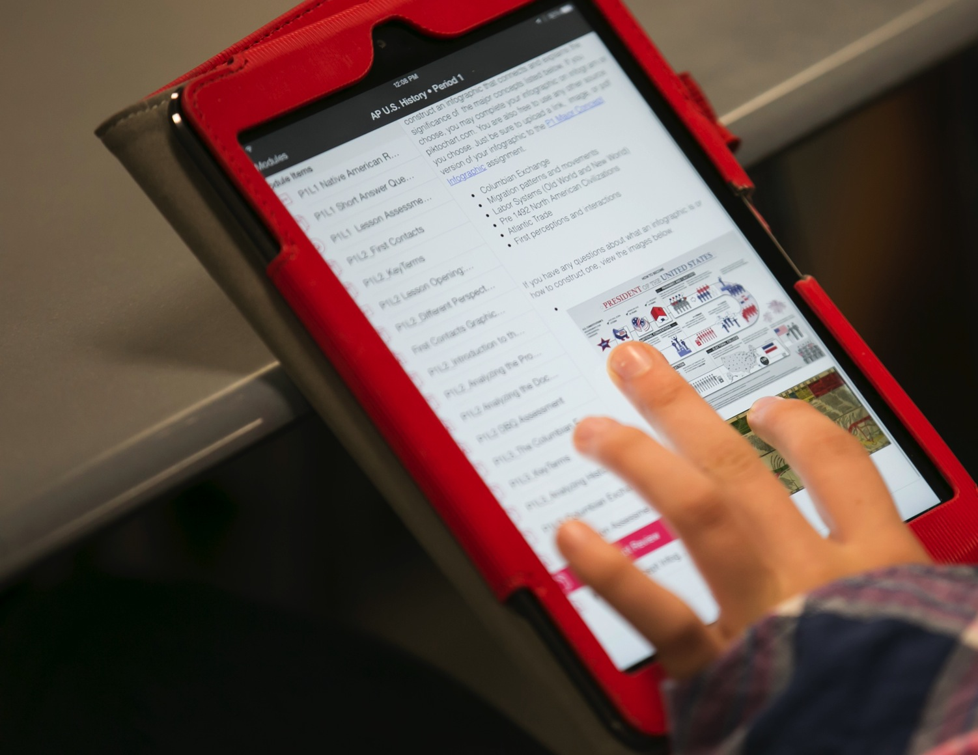

Notes:
Cam
The HCPSS is committed to providing students and staff a next generation learning environment in which every student has access to learning experiences and instruction designed around communication, collaboration, creativity, and critical thinking.
Bring your own device (BYOD) is a program that allows students in middle and high school to use their personal devices (phones or tablets) for instructional activities. BYOD enables students to connect to the network to gain access to instructional resources, class projects, etc.
BYOD is OPTIONAL. Students are never required or expected to bring a personally-owned device to school. When an instructional activity is planned that needs access to individual technology, devices will be provided for use for students who do not have their own technology.
Use of Personal Devices in school for non-instructional activities:
High school students may carry their personal communication devices with them during the school day. Devices must be turned off or silent at all times.
Devices may not disrupt instructional activities and should be put away (in pocket, backpack, or locker). Students may use their devices before and after school, during lunch, and during hallway transition times.
[Note: To clarify a common misperception: There are NO PLANS to introduce BYOD in elementary school.]
More information is available online at www.hcpss.org/byod and in the Student Parent Handbook.

Slide 24
Responsible Use of Technology and Social Media
Notes:
Cam
Communications technology, including social media, is a fact of modern life. Learning to use technology effectively and responsibly is an important part of every student’s education.
HCPSS has launched a year-long community campaign to encourage responsible use of technology and social media. Watch for posters like this, and other announcements and upcoming events for students and families to explore this important topic. Follow our progress online at #lastingimpressions.
Preventing cyberbullying is an important part of this effort. This is a growing problem affecting many students. As part of the campaign, this year all middle & high school agenda books include a page about Grace’s Law with tips for students to protect themselves and others. [see Grace’s Law handout]

Slide 25

Sunday, October 16
REGISTER NOW!
www.hcpss5k.com
Notes:
Choya
Each year HCPSS holds the Let’s Go HoCo 5K Race and family1-mile fun run. This year’s race promises to be even bigger and better.
The race will be held Sunday morning, October 16th on Columbia Gateway Drive (new location this year).
Registration is now open at www.hcpss5k.com.
Mark this date on your calendar and encourage your staff and your school families to participate.
The Race supports our system’s continued commitment to wellness – for healthy staff, healthy families and healthy kids.

Slide 26

Celebrating HCPSS Students, Staff, and Schools
Bimonthly magazine
Print and online
Student achievements
Dedicated staff
School activities
celebrate.hcpss.org
Notes:
Choya
Celebrate HCPSS is our new school system magazine. It offers interesting, colorful features about some of the most exciting school projects, inspiring people, and promising programs in HCPSS.
You’ll see print issues in our school lobby and in locations around the county. An online version is also available at celebrate.hcpss.org, which offers extra photos and additional information.
Let us know about the topics you’d like to see in Celebrate HCPSS!

Slide 27
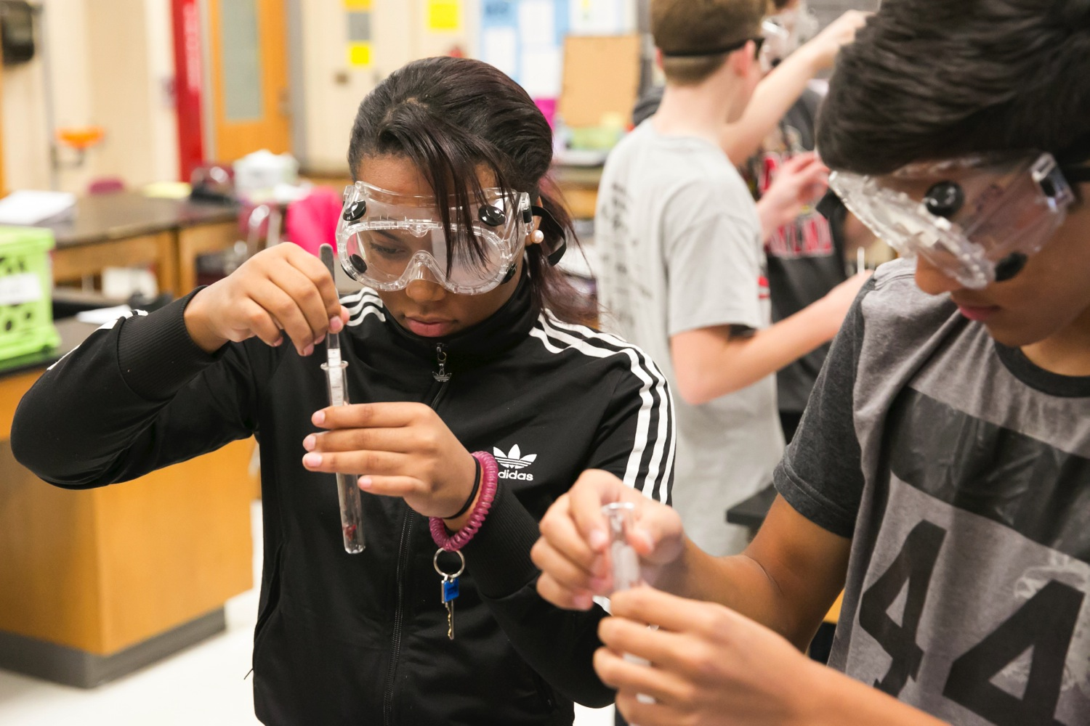
What Your Child Will Learn Guides
Algebra I
Biology
English 9-11
American Government
www.hcpss.org/academics
Notes:
Goldeisen
What Your Child Will Learn guides for high school provide an overview of the instructional program in for four curriculum areas: Algebra I, American Government, Biology and English. The guides include information that helps parents monitor and support their child’s progress during the school year.
The guides are available online only; print versions are no longer distributed. Specific guide webpages may be printed from the website.
Find the high school guides online at: www.hcpss.org/academics
The guides provide general information about content covered in each curriculum area. Specific student programs may differ, depending on instructional needs.

Slide 28
MRHS PTSA
2016 - 2017
Swami Swaminathan

Slide 29
Membership Benefits - Highlights
Senior Scholarship: $1500 scholarship for four seniors
Senior Banner: Special way to congratulate your dear and near seniors
Reflections: Learning arts through school community
Staff Hospitality: Recognize and appreciate the efforts of our great teachers at MRHS
After Prom Party: Fun-filled event with lot of games, music and food in a chemical-free environment
Restaurant Raffle: Families get an opportunity to win 12 restaurant gift cards

Slide 30
2016 – 2017 Budget
Income |  |  |  | Expenses
Corporate ACH Rebate |  | 3,000.00 |  | Dues |  | 3,370.00
Membership Deposits |  | 8,000.00 |  | Insurance & Bonding |  | 205.00
Afterprom Revenues |  | 22,000.00 |  | Administrative Costs |  | 1,200.00
SAT Prep Contributions |  | 4,000.00 |  | Hospitality |  | 5,350.00
Fundraiser |  | 4,000.00 |  | Scholarships |  | 6,100.00
Total |  | 41,000.00 |  | After Prom Event |  | 22,500.00
 |  |  |  | Student/Family Programs |  | 1,275.00
 |  |  |  | Fundraiser |  | 1,000.00
 |  |  |  | Total |  | 41,000.00

Slide 31
Let your voices be heard…
Participate in PTSA meeting held second Tuesday of every month 7:00PM at Marriotts Ridge High School Staff Lounge
Call or Email PTSA executive committee member(s) to share your thoughts

Slide 32
Learn more about MRHS PTSA at…
http://www.marriottsridgeptsa.org/

Slide 33
Thank you

